Slide 1
Webmaster report
Contact Lorie S.
webmaster@al-anon.ab.ca

Slide 2
When was the last time you really looked at our website?
Do you know what is on our website?
Do you know we have Information for Members?
Do you know the Password for the Info for Members page?
Did you know all the contact information for the World Service Office in Virginia Beach is on our website?
Did you know we have a Al-Anon Family Group Headquarters in Canada and that information is on the website?
Did you know there is a different meeting list on our website than with the World Service Office?

Slide 3
I didn’t know all this plus more was available until I took over this position in January….THANK YOU FOR YOUR PATIENCE
Did you know we have links to posters
There is a link to the Official Mobile App
There is a link to the book store in Calgary
We have an events page like we used for registration but can use for many events for Al-Anon or AA events with Al-Anon participation
Did you know I need you to have a look at the site and let me know if anything is incorrect?
I need you to help me as I am learning – and our website can do much more- so we shall see where I get with that in my term
We have a link for newcomers on Saturday which is on a volunteer basis from our members

Slide 4
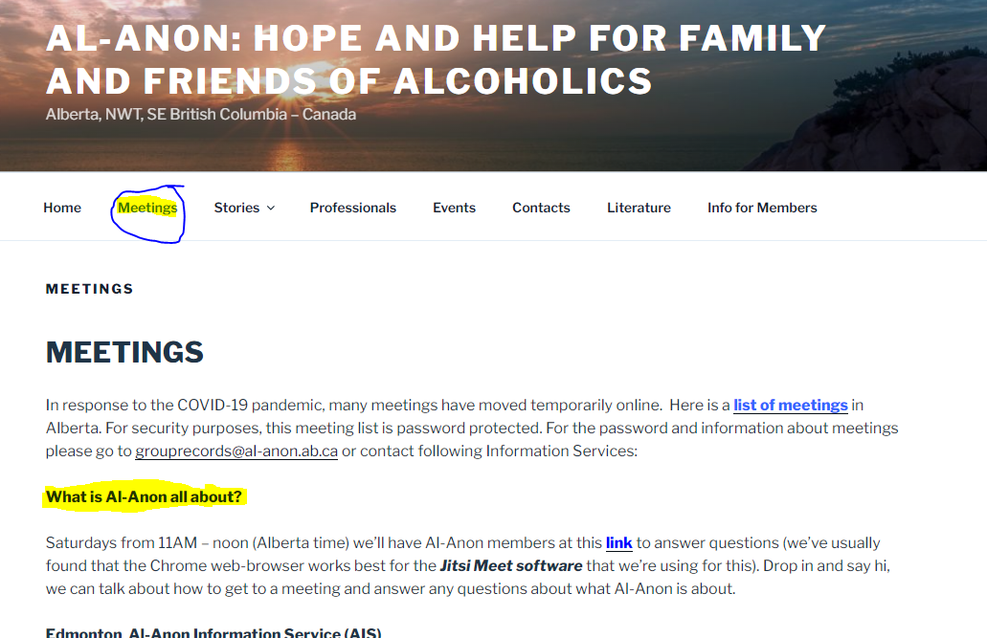
Did you know we have a newcomer meeting?
Password Info for Members Area80

Slide 5
What you need to know and share with your group members and for Public Outreach
Our Area website is: www.al-anon.ab.ca
Email for events with posters is events@al-anon.ab.ca
Password for the Info for Members page is Area80

Slide 6
Question why is the meeting list password protected?
Pros of eliminating password
Quicker, easier, friendlier access to meeting information for newcomers, visitors and current members-a more efficient way to serve our primary purpose
As more groups return to in person, the Area web meeting list becomes further weighted towards in-person meeting info which can be displayed generally without password concern on the site
Zoom bombing is now much less common when we started and people who are chairing meetings are comfortable in the operation of hosting a zoom meeting
Newcomers don’t have to wait for the password from Group Records to receive a password via email
Double headed management avoided (Concept Ten) WSO and Area

Slide 7
What would happen if we removed the password for the meeting list?
Possible security target of web deviants for personal emails used instead of a group email
If there was a unwelcome snooper would the host know how to remove from a zoom meeting
Risking the anonymity of people in meetings, may no longer be true that we’re all there for the same purpose
Some groups currently do not want their zoom info posted publically
Newcomers wouldn’t have to email for meeting info even though Donna J. who answers those emails is prompt and makes it a very personable experience in answering their questions

Slide 8
Thanks to my committee who assisted in gathering this information
Sharon A. (currently updates the meeting list on our website)
Jason D. ( Past Webmaster)
Donna J. ( Group Records Coordinator)

